Slide 1
Government AIR Review

Slide 2
Types of Government
Autocracy
Dictator, Absolute Monarchy, Totalitarian Dictator, Theocracy
Oligarchy
Democracy
Presidential & Parliamentary
Limited or Constitutional Monarchy

Slide 3
Government Types
What is a government ruled by 1 person?
What is a government ruled by a few people?
What is a government ruled by the people?

Slide 4
Government Types
1 person in power is an autocracy
A few people in charge is an oligarchy
All the people hold power is a democracy

Slide 5
What was the Enlightenment?
A time period when the belief spread that people could think for themselves without a king or church to do it for themselves

Slide 6
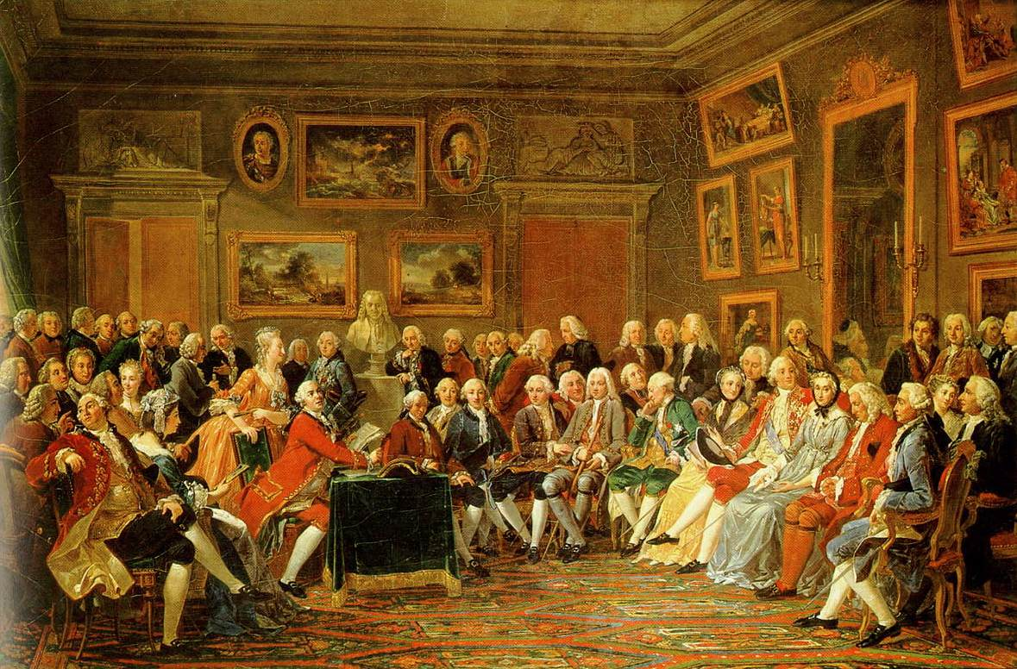
What types of tings did we believe we should make our own decisions about??
Voting
Taxes
Jobs
Trade
Buying
War
Military service
Religion

Slide 7
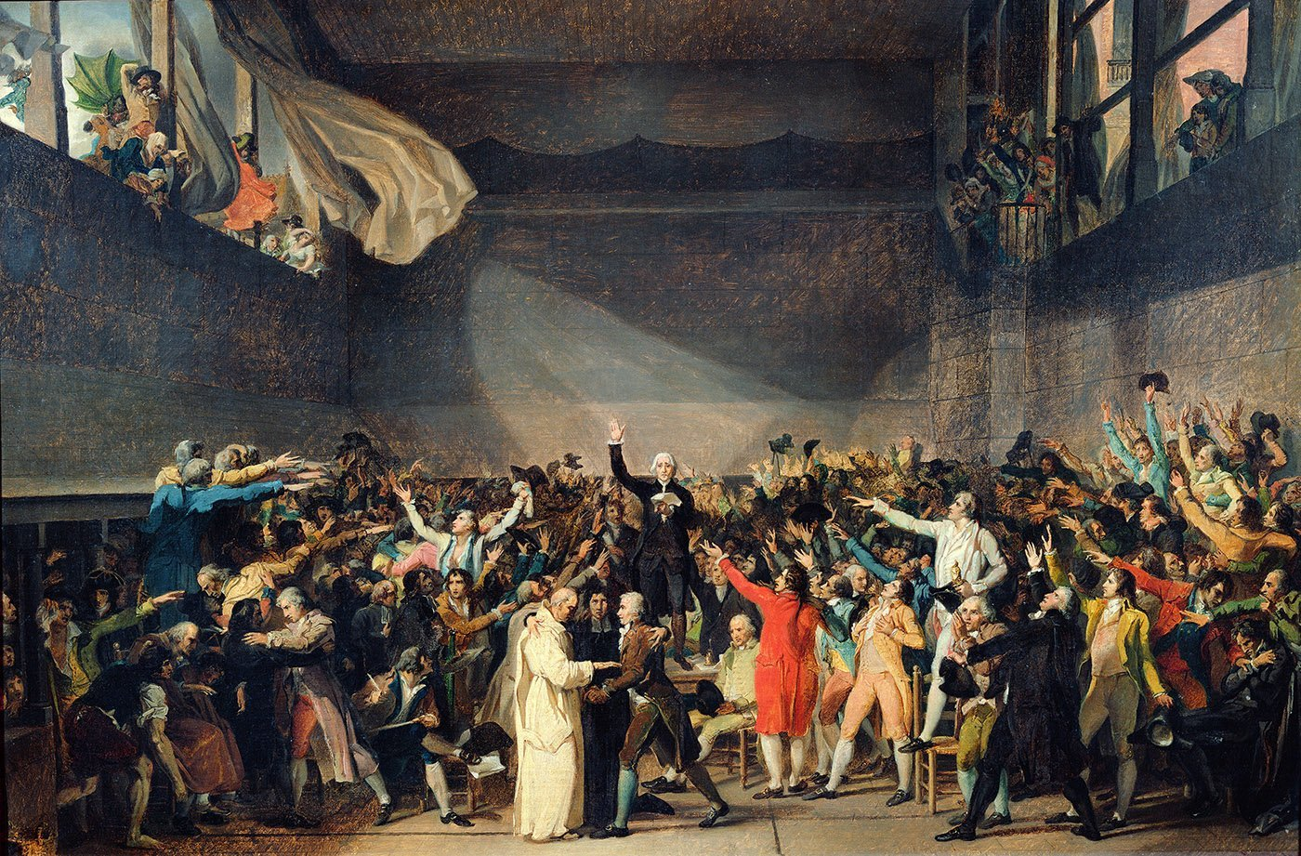
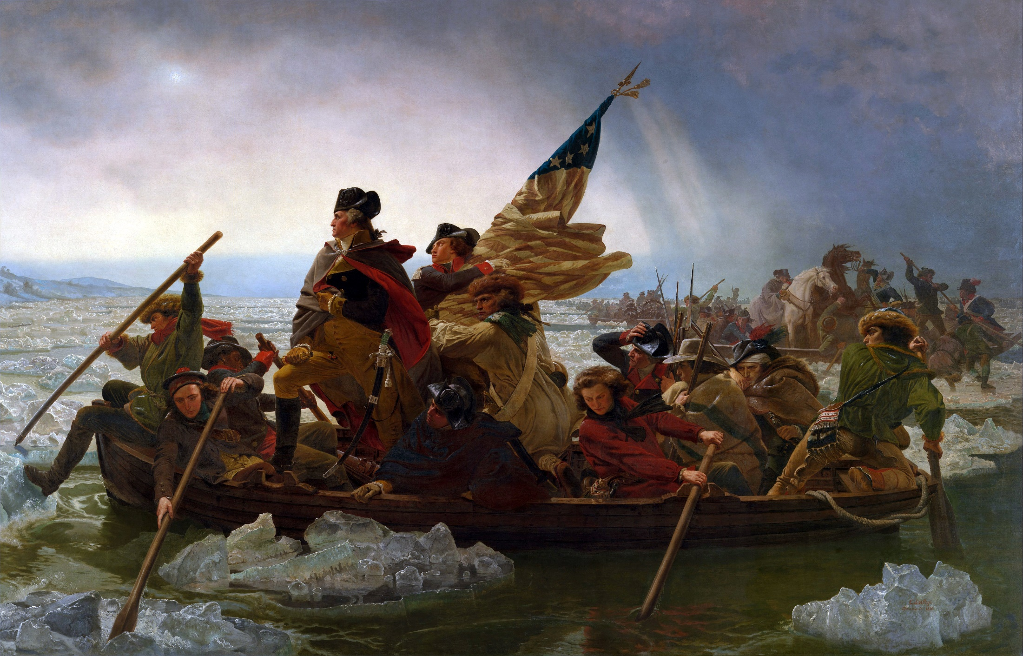
What were the major results of the Enlightenment?
American & French Revolutions
Birth of Modern Democracy
Birth of Capitalism

Slide 8
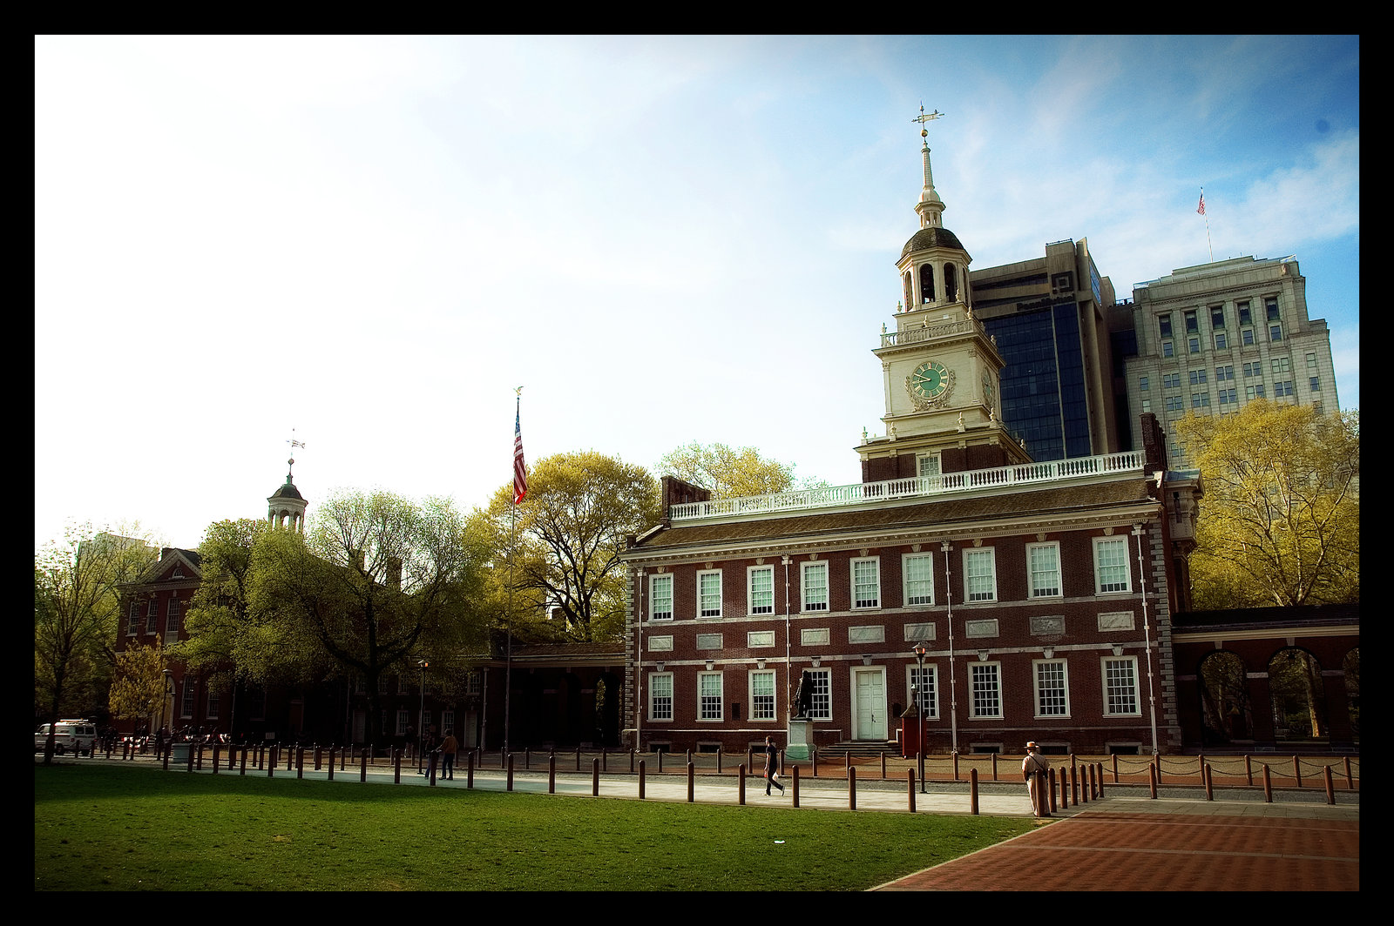
Where & when did America’s Founding Fathers first express these ideas?
Declaration of Independence

Slide 9
Where the basic ideas in the Declaration of Independence that America was based upon?
All men are created equal
We are all born with natural rights such as life, liberty, and the pursuit of happiness

Slide 10
What government did America’s Founding Fathers first create that was based on these ideas?
Articles of Confederation

Slide 11
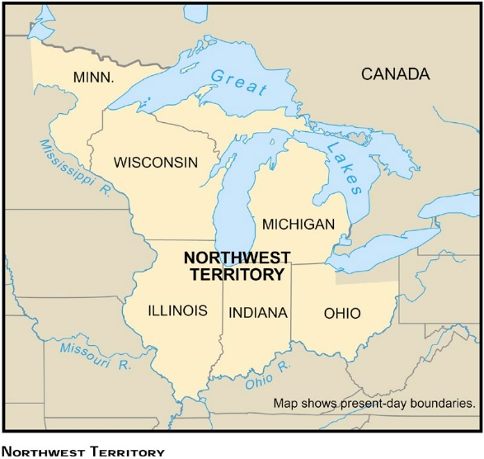
What law was created to allow new states to join the U.S. as long as they were based upon the ideas of Declaration?
The Northwest Ordinance

Slide 12
What was wrong with the Articles of Confederation?
No president
No power to tax
No power to raise a military
No power to print money
All the power to the states

Slide 13
What new government was created to correct the problems of the Articles of Confederation?
The U.S. Constitution

Slide 14
How could we make sure the Constitution did not create a government that was too powerful?
The U.S. Constitution

Slide 15
Constitutional Principles
Popular sovereignty
authority derived from the people; consent of governed
Limited government
government can only exercise powers granted to it; according to the rule of law
Federalism
power is divided between a central authority and constituent units (national government and states)
Separation of powers
distribution of powers among independent branches
Checks and balances
controlling government power - branches can restrain actions of other branches

Slide 16
Resolution of Conflict
Persuasion
inducing others into accepting a point of view through reasoning and argumentation
Compromise
making concessions
Consensus building
working toward achieving general agreement
Negotiation
settling differences through discussion of issues

Slide 17
Unique Amendments
11th Amendment
21st Amendment
27th Amendment

Slide 18
Presidential Amendments
12th Amendment
20th Amendment
22nd Amendment
23rd Amendment
25th Amendment

Slide 19
Suffrage Amendments
15th Amendment
19th Amendment
24th Amendment
26th Amendment

Slide 20
Progressive Era Amendments
16th Amendment
17th Amendment
18th Amendment
19th Amendment
20th Amendment

Slide 21
Civil War/Reconstruction Amendments
13th Amendment
14th Amendment
15th Amendment

Slide 22
Fiscal Policies
Expansionary
increased government spending and reduced taxes to increase aggregate demand
Contractionary
decreased government spending and increased taxes to decrease aggregate demand
Difficulties
much govt spending is fixed; expansionary policies could result in inflation and contractionary could result in recession; expansionary policies are popular, contractionary policies are unpopular
Government regulations
Benefits - prohibit unfair business practices, consumer protection;
Costs -reduced corporate profits, slower econ. growth

Slide 23
Monetary Policies
Monetary tools by Federal Reserve
Open market operations, discount rate, reserve requirement
Purchasing govt securities, reducing discount rate, reducing reserve requirement → increase money supply, decrease interest rates, encourage spending, foster expansion
Selling govt securities, increasing discount rate, increasing reserve requirement → reduce money supply, increase interest rates, depress spending, foster contraction

Slide 24
The Federalists
The Anti-Federalists
Preferred a federal government over a confederacy
Did not believe citizen rights needed to be written
Believed a strong national government was necessary to provide unity and security
Wanted a standing army to protect the nation
Preferred a confederacy over a federal government
Wanted citizen rights to be listed in the Constitution
Believed the national government held too much power compared to states
Feared a standing army could lead to dictatorship

Slide 25
Is the following statement an example of Federalist or Anti-Federalist beliefs? “I wish for nothing more than a good government and a constitution under which our liberties will be perfectly safe. To preserve which, I think the wisest conduct will be to keep the staff of power in our own hands as much as possible…and not give up a greater share of our liberties.” A. Federalist B. Anti-Federalist

Slide 26
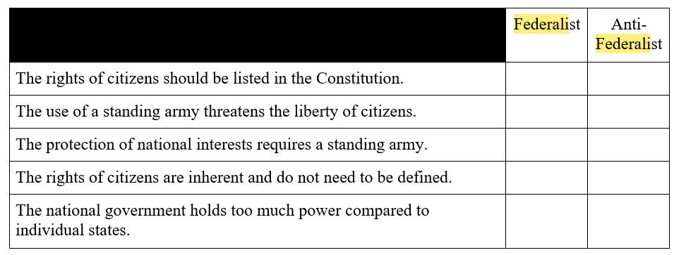
Federalists and Anti-Federalists debated issues and concerns related to the proposed Constitution. Select the boxes to identify each argument as a Federalist position or an Anti-Federalist position.

Slide 27
Executive Branch
The U.S. Constitution
Article 1
Article 2
Article 3
Legislative Branch
Judicial Branch

Slide 28
Who is the Executive Branch?
The U.S. Constitution
Who is the Legislative Branch?
Who is the Judicial Branch?
Congress
Supreme Court
The President
House of Representatives
Senate

Slide 29
The President
Separation of Powers
Congress
Supreme Court
House of Representatives
Senate
Federalism
The States

Slide 30
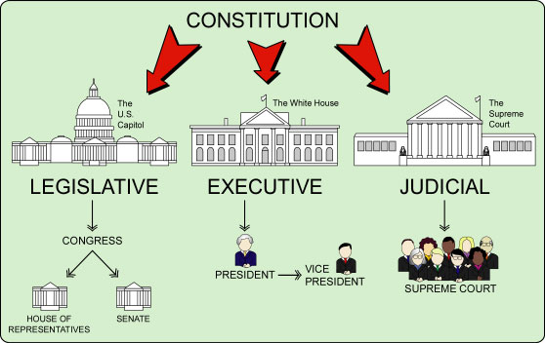
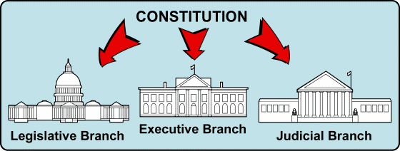
Separation of Powers

Slide 31
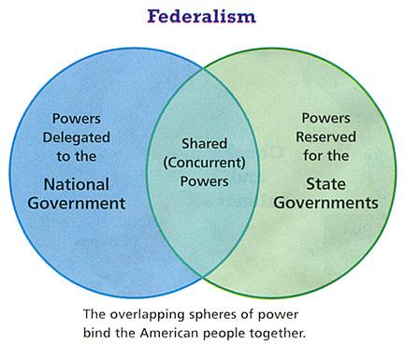
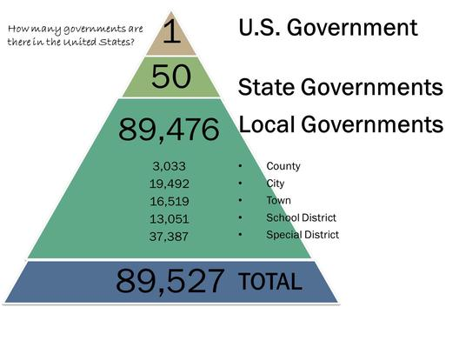
Major Constitutional Principles
Popular Sovereignty
Federalism

Slide 32
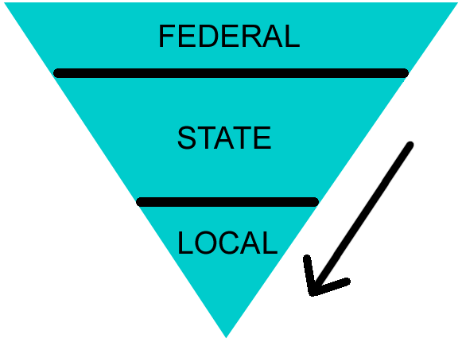
Federalism

Slide 33
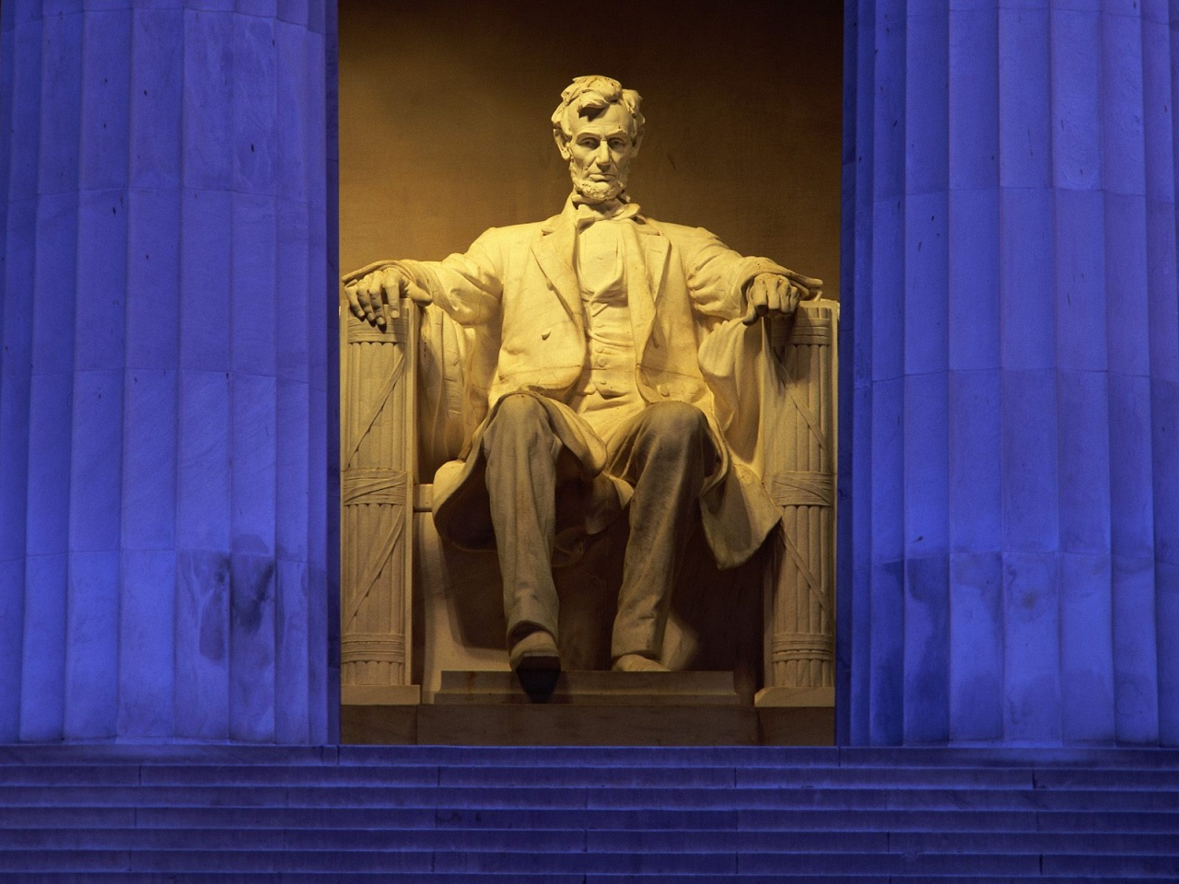
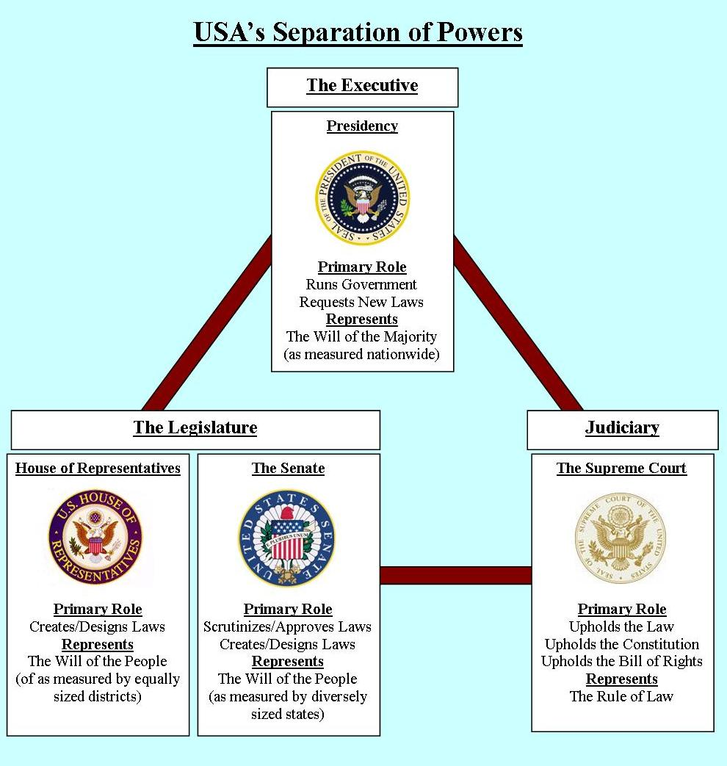

Slide 34
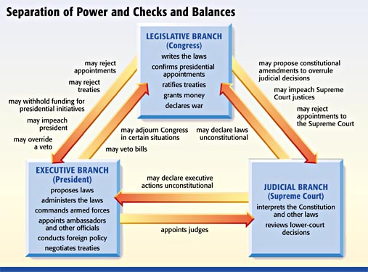

Slide 35
Credibility & Bias
How can you tell whether something is credible or biased?
What is “real news” and what is “fake news”?

Slide 36
Which source would provide the most credible information about the daily life of factory workers during the 1880s?
A. a collection of letters written by a farmer
B. a journal written by an employee at a factory
C. a novel written to encourage factory regulation
D. a pamphlet written by a group opposing unions

Slide 37
The Legislative Branch
Article 1
What is it?
U.S. Congress
U.S. Senate & House of Representatives

Slide 38
The Legislative Branch
What are its powers?
Declare war
Approve the budget
Approve treaties
Approve all appointments
Impeach the president

Slide 39
The Legislative Branch
What are the checks on its powers?
Voted out of office
Vetoed
Ruled unconstitutional by the Supreme Court

Slide 40
The Executive Branch
Article 2
What is it?
The President
The Executive Departments & Offices

Slide 41
The Executive Branch
What are its powers?
Appoint Supreme Court justices
Commander-in-chief
Appoint department heads
Negotiate treaties
Veto Congress
Propose the budget

Slide 42
The Executive Branch
What are the checks on its powers?
Vetoes can be overridden
Can be impeached
Can be voted out of office
Can be overruled by the Supreme Court

Slide 43
The Judicial Branch
Article 2
The Supreme Court

Slide 44
The Judicial Branch
What are its powers?
Judicial review
Judge the constitutionality of all government actions

Slide 45
The Judicial Branch
What are the checks on its powers?
Can be impeached
Can be overruled by future Supreme Courts
The Constitution can be amended
Appointed by the president

Slide 46
1. What event brought about the adoption of the 25th amendment?
A. President Woodrow Wilson became seriously ill while in office, leaving his ability to perform the duties of president uncertain.
B. President John F. Kennedy was assassinated and was succeeded by vice president Johnson, who had heart problems himself.
C. When president Franklin Roosevelt died in office, he was succeeded by Vice President Truman, leaving the office of the vice president vacant.
D. President Ronald Reagan was injured in an assassination attempt and was incapacitated for a day, leaving presidential leadership uncertain.

Slide 47
2. During the 1920s, the manufacture, sale, transportation, import, or export of alcoholic beverages was illegal across the United States. Why did it take the ratification of the 21st Amendment to the Constitution in 1933 to make alcohol manufacture, sale, transportation, importation, or exportation legal again?
A. The states each had conflicting versions of the law.
B. The Supreme Court refused to rule on the federal law banning alcohol.
C. Congressional representatives knew they would lose votes if they reversed the original federal law.
D. Alcohol was banned by an amendment to the Constitution, and only another amendment could repeal it.

Slide 48
3. What was one change made by the 1851 Ohio Constitution that affected how the state was governed?
A. The 1851 Ohio Constitution increased the power of the General Assembly.
B. The 1851 Ohio Constitution limited the amount of debt the state could accumulate.
C. The 1851 Ohio Constitution permitted the General Assembly to enact retroactive laws.
D. The 1851 Ohio Constitution lifted a restriction on how the state could spend its tax funds.

Slide 49
4. The 20th Amendment, ratified in 1933, shortens the period between Election Day and the time when the president and members of Congress take office. What situation made the 20th Amendment a practical improvement?
A. The Electoral College needed more time to certify the results of the election.
B. The public demanded more results from newly elected administrations and wanted the president and Congress to begin serving sooner.
C. Better and faster transportation made the long delay between the election of a new president and the inauguration unnecessary.
D. After the election, the outgoing president was eager to step down and hand over the heavy responsibility of the office to another leader.

Slide 50
5. Citizens must choose between a plan to build a new city auditorium or a plan to restore the old one. Supporters of the new auditorium claim that building a new auditorium would be more economical than restoring the old one. In evaluating the credibility of this claim, citizens should pay particular attention to
A. the number of performances held in the auditorium each year.
B. the amount of money the supporters spend on promoting their position.
C. the popularity of the supporters as community leaders.
D. the projected cost data provided by architects and accountants.

Slide 51
6. The Federal Reserve uses monetary tools to regulate the money supply and maintain growth and stability in the U.S. economy. One of these tools is the adjustment of the discount rate it charges financial institutions on loans from the Federal Reserve. Identify whether each of the Effects stems from increasing or decreasing the discount rate.
People buy more houses
People pay more for loans
Inflation increases

Slide 52
7. A town council faces budget cuts and can no longer afford to pay for landscaping in town parks. How could a citizen work within his or her own community to help the local government address this problem?
A. by emailing Ohio’s congressional delegation to inform them of this issue
B. by organizing a group of residents to volunteer for weekly park maintenance
C. by requesting that the governor supply the town with state funds for park maintenance
D. by running for a seat in the General Assembly with a promise to increase funding for local parks

Slide 53
8. Federalism is one of the basic principles established in the U.S. Constitution. Describe how government in the United States reflects a federal structure.

Slide 54
9. Why might lawmakers increase taxes and decrease government spending?
A. to reduce unemployment
B. to increase consumer spending
C. to decrease the level of demand
D. to encourage corporate spending

Slide 55
10. Identify the perceived conflict of interest that led to the ratification of the 27th Amendment.

Slide 56
11. Citizens need to understand how to engage the government properly at various stages of a bill’s passage. Identify the appropriate branch and level of government to target in each scenario shown for a bill.
The U.S. Congress begins debate on a bill.
Branch: Executive, Judicial, or Legislative
Level: State or Federal
The bill becomes law and the Governor of Ohio directs agencies to implement its provisions.
Branch: Executive, Judicial, or Legislative
Level: State or Federal
The Ohio Supreme Court Hears arguments over challenges to the law.

Slide 57
12. The following question has two parts. First, answer part A. Then, answer part B. Part A: After the end of the Civil War, which goal did the federal government hope to accomplish during Reconstruction?
A. extending rights to southern women
B. establishing freedoms for former slaves
C. ensuring political power for Southern Democrats
D. guaranteeing southern white control over the social and economic condition of African-Americans

Slide 58
12. Part B: Select all of the ways the federal government attempted to accomplish the goal you selected in Part A.
A. abolishment of slavery
B. establishment of Jim Crow laws
C. ratification of the 14th Amendment
D. ratification of the 19th Amendment
E. guaranteeing African Americans the right to vote

Slide 59
13. Amendments to the U.S. Constitution have been made to extend voting rights to disenfranchised groups. Identify which group was extended voting rights by each amendment.
15th Amendment, 1870 _________________
19th Amendment, 1920 ______________
26th Amendment, 1971 ______________

Slide 60
14. Use your knowledge of Federalists vs. Anti-Federalists to identify which group held each of the positions shown.
Federalist or Anti-Federalist
In the compound republic of America, the power surrendered by the people is first divided between two distinct governments, and then the portion allotted to each subdivided among distinct and separate departments. Hence a double security arises to the rights of the people. The different governments will control each other, at the same time that each will be controlled by itself.

Slide 61
14. Use your knowledge of Federalists vs. Anti-Federalists to identify which group held each of the positions shown.
Federalist or Anti-Federalist
I wish for nothing more than a good government and a constitution under which our liberties will be perfectly safe. To preserve which, I think the wisest conduct will be to keep the staff of power in our own hands as much as possible…give up a greater share of our liberties.

Slide 62
15. How can a citizen become involved in addressing problems that affect the entire state?
A. by joining a community watch group
B. by volunteering for the fire department
C. by signing petitions to place issues on the ballot
D. by attending a meeting of the local school board

Slide 63
16. In 1851, Ohio drafted a new constitution that was meant to address problems of the original state constitution. These problems included: • An overburdened judicial branch • A significant amount of state government debt • A overly powerful legislative branch
A. It created district courts.
B. It instituted debt limitations.
C. It forgave all outstanding state debt.
D. It allowed the judicial branch to appoint legislative officials.
E. It required major executive officials to be elected into office.
F. It restricted the number of cases that could be brought to trial in the state each year.

Slide 64
17. Which statement accurately describes the relationship between the Ohio Constitution and the U.S. Constitution?
A. Ohio laws overrule federal laws when there is a conflict.
B. All articles of the Ohio Constitution must be the same as all articles of the U.S. Constitution.
C. The structure of the Ohio Constitution does not resemble the structure of the U.S. Constitution.
D. The Ohio Constitution is consistent with the key principles of the U.S. Constitution, but contains some laws that differ from the laws of the U.S. Constitution.

Slide 65
18. Identify the responsibilities of each branch of government.
A. Proposes federal budget
B. Sentences those who break the law
C. Institutes impeachment proceedings
D. Interprets the laws
E. Approves treaties with foreign nations
F. Recognizes foreign nations

Slide 66
19. The 17th Amendment established the direct election of U.S. senators. Identify whether each group supported or opposed the ratification of the 17th Amendment.
A. Wealthy business owners
B. State political bosses
C. Members of the Populist Party
D. Critics of powerful state legislatures

Slide 67
20. A state is considering an amendment to its constitution requiring that judges be appointed rather than elected. A supporter of the amendment makes the following statement:
Electing judges allows choices to be made on the basis of political influence, not merit. I believe that it is time to consider changing this practice to a system whereby judges are appointed by the governor and confirmed by the legislature. Our State Bar (lawyers) Association supports this change because during election years, campaigning and fundraising for the election of judges delays the hearing of cases. This creates a backlog in the year following the election. Furthermore, a survey of voter habits by the State Election Commission reports that 60% of voters fail to vote for judges at all. Voters say they lack relevant criteria for making selections. The Commission has stated its support for the amendment in order to better assure that judges have been chosen on their merits rather than their appeal to special interests.
Explain why the use of the particular sources presented by the supporter of the amendment makes the supporter’s position credible. Be sure to refer to:
• the qualifications of the sources; • the consistency (agreement) between the sources.

Slide 68
21. Explain how the passage of the 19th Amendment changed the U.S. Constitution to allow greater participation in government. Be sure to note a restriction on voting that the 19th Amendment addressed. Then, explain how the passage of the 26th Amendment continued the change toward greater participation in government. Be sure to note a restriction on voting that the 26th Amendment addressed.

