Slide 1
American History
The Early Years Review

Slide 2
Types of Government
Autocracy
Dictator, Absolute Monarchy, Totalitarian Dictator, Theocracy
Oligarchy
Democracy
Presidential & Parliamentary
Limited or Constitutional Monarchy

Slide 3
Government Types
What is a government ruled by 1 person?
What is a government ruled by a few people?
What is a government ruled by the people?

Slide 4
Government Types
1 person in power is an autocracy
A few people in charge is an oligarchy
All the people hold power is a democracy

Slide 5
What was the Enlightenment?
A time period when the belief spread that people could think for themselves without a king or church to do it for themselves

Slide 6
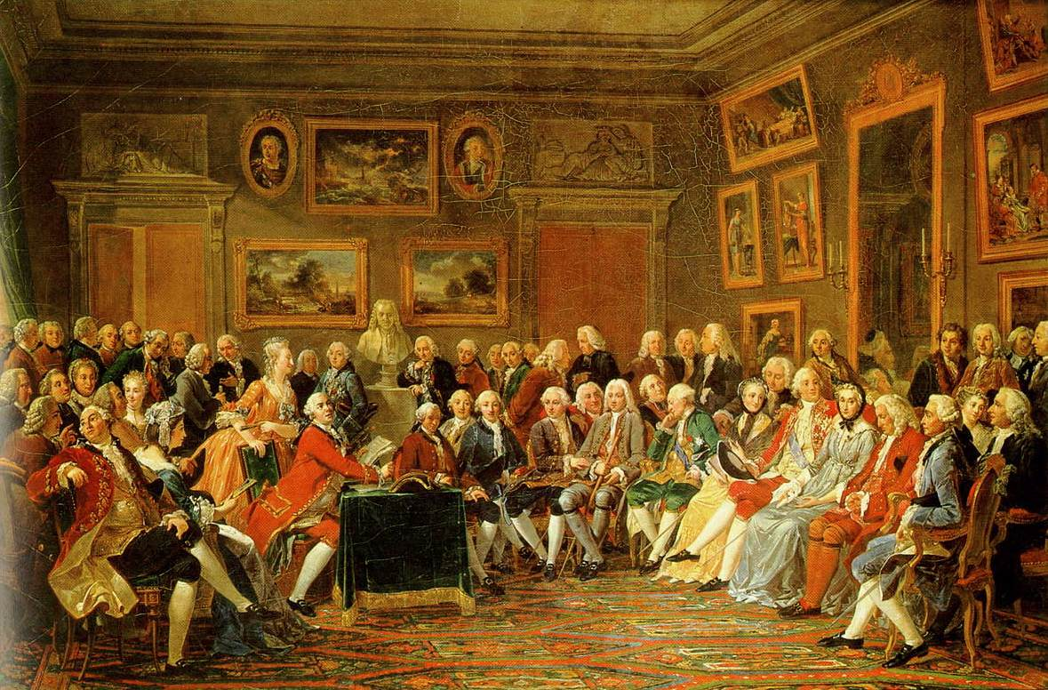
What types of tings did we believe we should make our own decisions about??
Voting
Taxes
Jobs
Trade
Buying
War
Military service
Religion

Slide 7
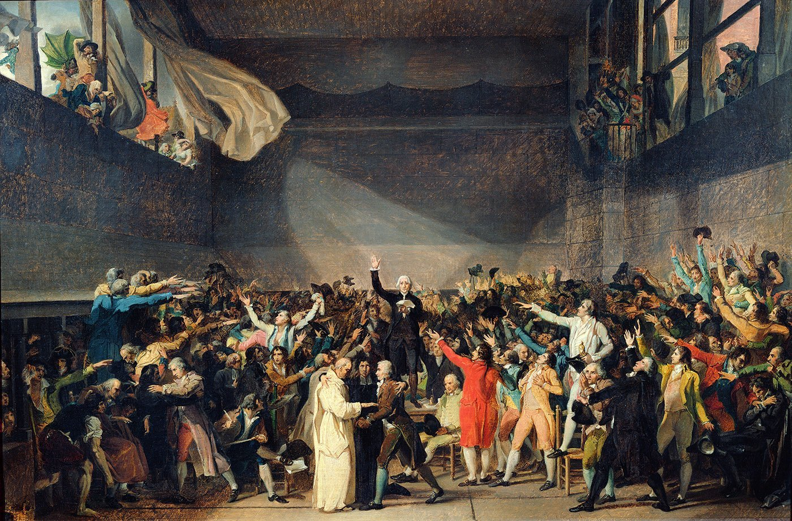
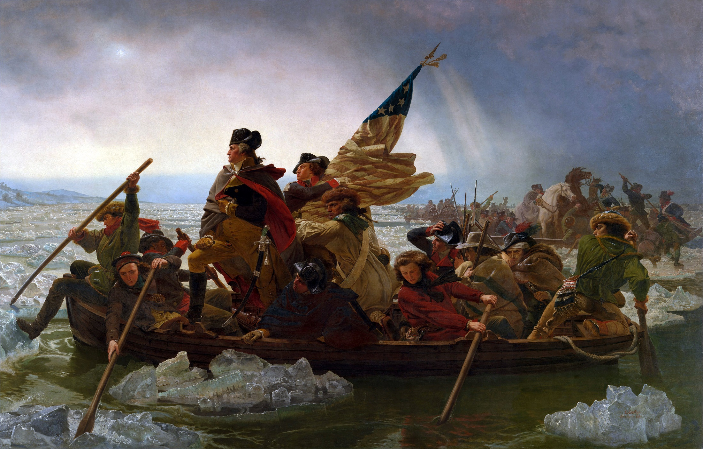
What were the major results of the Enlightenment?
American & French Revolutions
Birth of Modern Democracy
Birth of Capitalism

Slide 8
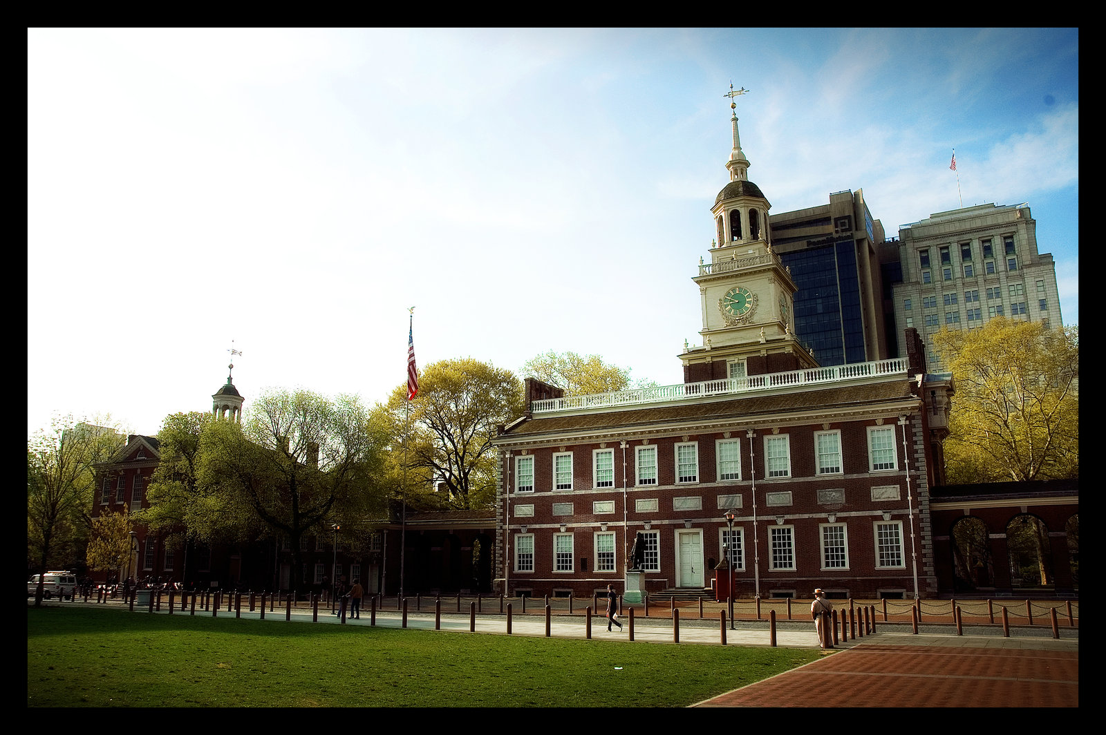
Where & when did America’s Founding Fathers first express these ideas?
Declaration of Independence

Slide 9
Where the basic ideas in the Declaration of Independence that America was based upon?
All men are created equal
We are all born with natural rights such as life, liberty, and the pursuit of happiness

Slide 10
What government did America’s Founding Fathers first create that was based on these ideas?
Articles of Confederation

Slide 11
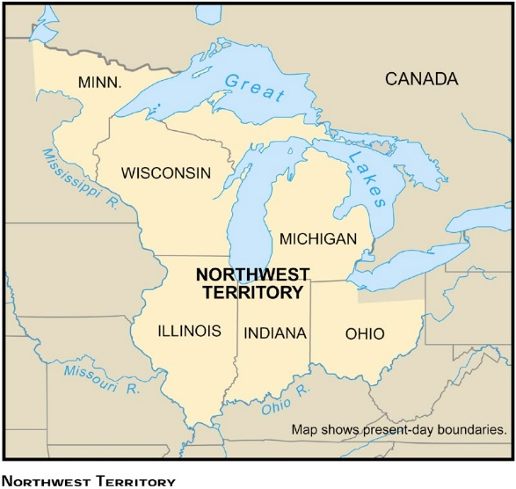
What law was created to allow new states to join the U.S. as long as they were based upon the ideas of Declaration?
The Northwest Ordinance

Slide 12
What was wrong with the Articles of Confederation?
No president
No power to tax
No power to raise a military
No power to print money
All the power to the states

Slide 13
What new government was created to correct the problems of the Articles of Confederation?
The U.S. Constitution

Slide 14
How could we make sure the Constitution did not create a government that was too powerful?
The U.S. Constitution

Slide 15
The Federalists
The Anti-Federalists
Preferred a federal government over a confederacy
Did not believe citizen rights needed to be written
Believed a strong national government was necessary to provide unity and security
Wanted a standing army to protect the nation
Preferred a confederacy over a federal government
Wanted citizen rights to be listed in the Constitution
Believed the national government held too much power compared to states
Feared a standing army could lead to dictatorship

Slide 16
Is the following statement an example of Federalist or Anti-Federalist beliefs? “I wish for nothing more than a good government and a constitution under which our liberties will be perfectly safe. To preserve which, I think the wisest conduct will be to keep the staff of power in our own hands as much as possible…and not give up a greater share of our liberties.” A. Federalist B. Anti-Federalist

Slide 17
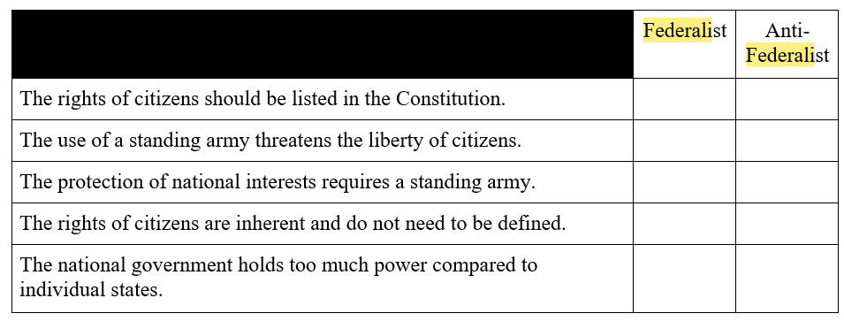
Federalists and Anti-Federalists debated issues and concerns related to the proposed Constitution. Select the boxes to identify each argument as a Federalist position or an Anti-Federalist position.

Slide 18
Executive Branch
The U.S. Constitution
Article 1
Article 2
Article 3
Legislative Branch
Judicial Branch

Slide 19
Who is the Executive Branch?
The U.S. Constitution
Who is the Legislative Branch?
Who is the Judicial Branch?
Congress
Supreme Court
The President
House of Representatives
Senate

Slide 20
The President
Separation of Powers
Congress
Supreme Court
House of Representatives
Senate
Federalism
The States

Slide 21
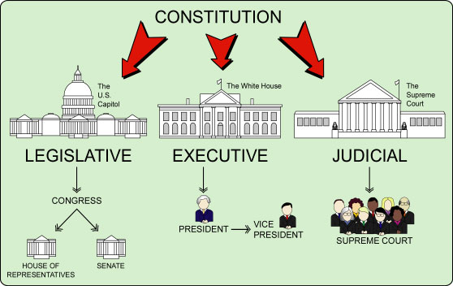
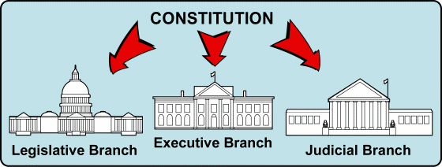
Separation of Powers

Slide 22
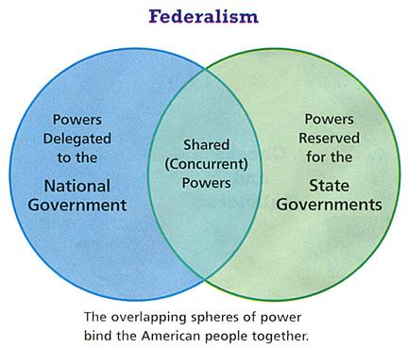
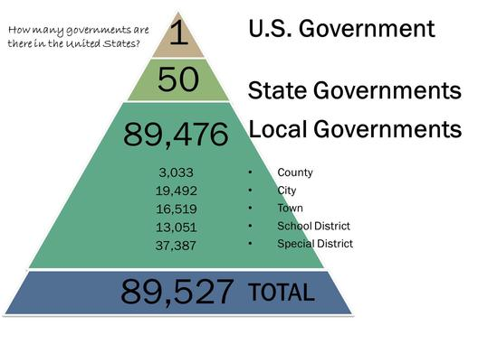
Major Constitutional Principles
Popular Sovereignty
Federalism

Slide 23
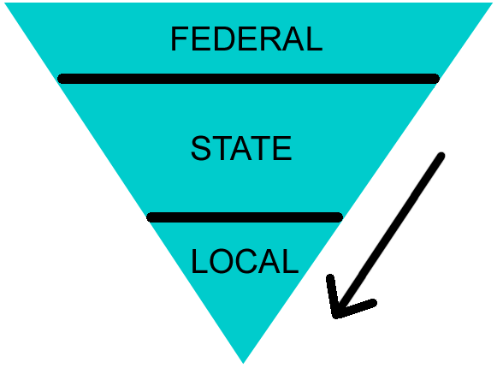
Federalism

Slide 24
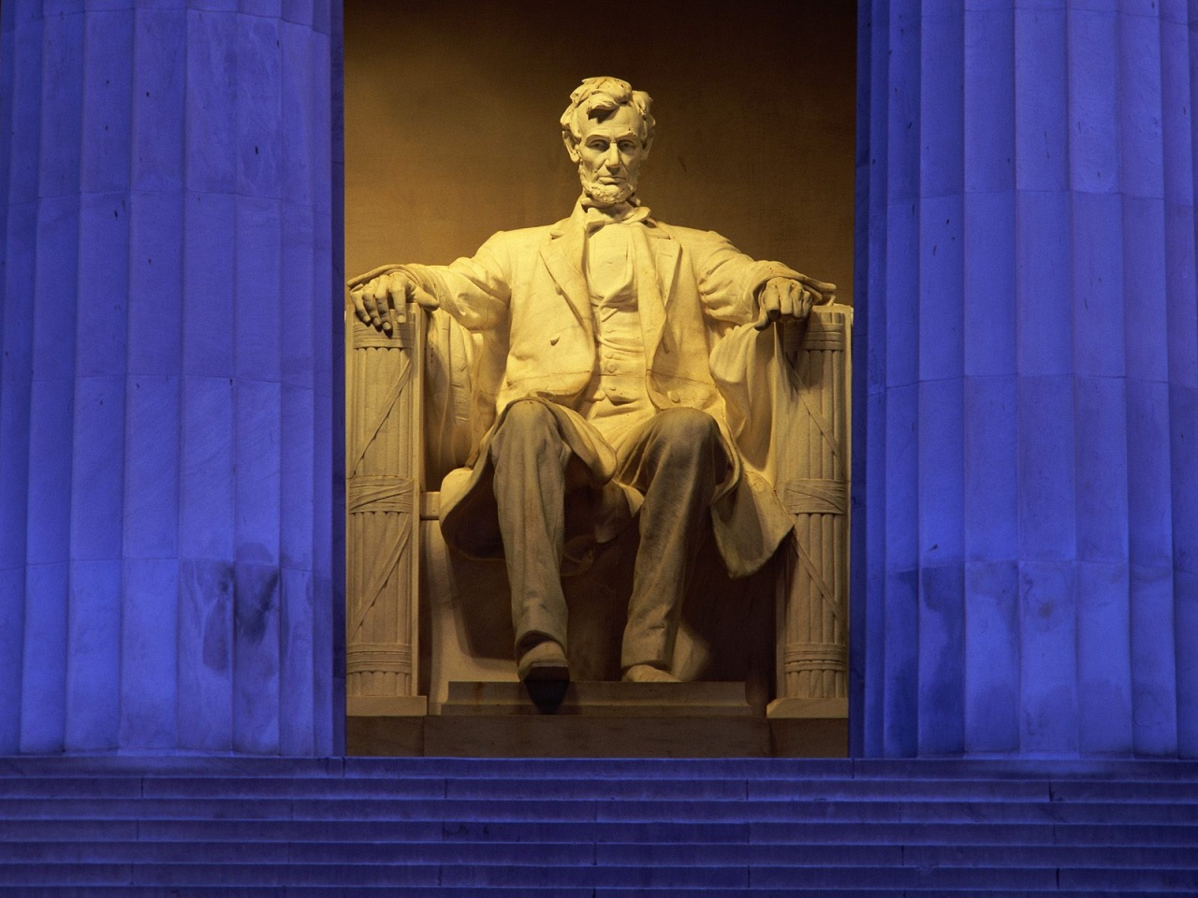
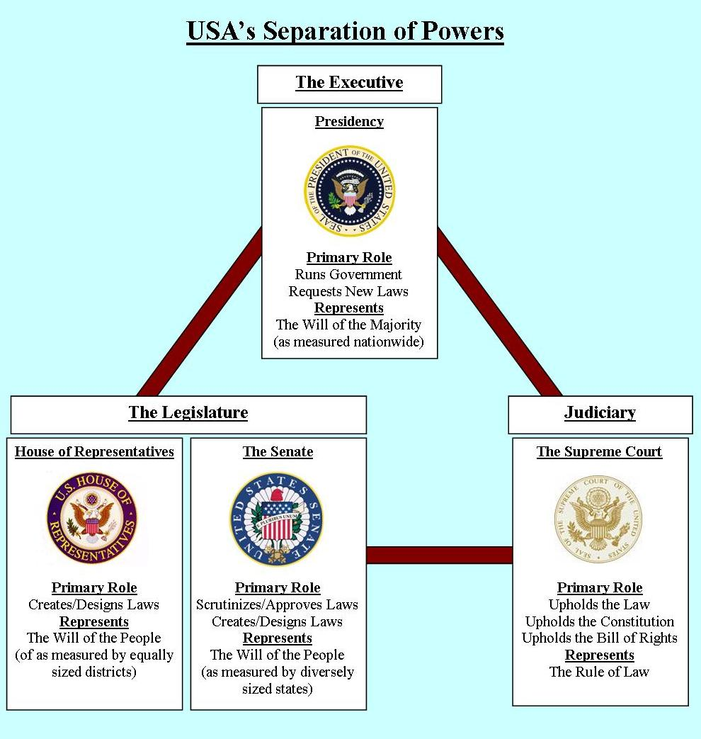

Slide 25
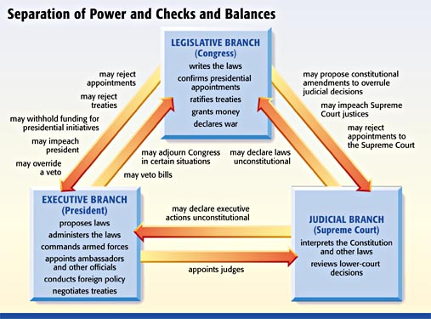

Slide 26
Since the birth of the nation, the struggle has been to adapt and fulfill its role as a “new nation conceived in liberty and dedicated to the proposition that all men are create equal”.

Slide 27
What are the issues with which America has struggled?
Economic Growth
Social Classes
Geographic Expansion
Slavery
How much government is too much?
African-Americans
Irish
Catholics
Women
Asians
Hispanics

Slide 28
How has the Constitution changed to help make the ideas of the Declaration & Enlightenment more realistic?
Outlawed slavery
Made blacks citizens
Given blacks, women, & 18 years the right vote

Slide 29
How was the Constitution designed to reflect the changes that American society would go through?
Amendments

Slide 30
How was the Constitution designed to reflect the changes that American society would go through?
Amendment 1
Amendment 4
Amendment 13, 14, 15
Amendment 16
Amendment 17
Amendment 18
Amendment 19
Amendment 20
Amendment 21
Amendment 24
Amendment 26

Slide 31
In 1816 Thomas Jefferson wrote:
“I am certainly not an advocate for frequent and untried changes in laws and constitutions… But I also know that laws and institutions…must advance…and keep pace with the times.”
Letter to Samuel Kercheval, July 12, 1816
Which thesis about Jefferson’s beliefs does the statement above support?
A. Laws must change as society changes.
B. Laws and constitutions have little permanent value.
C. People have limited ability to govern themselves wisely.
D. The rights of individual must be balanced against the common good.

Slide 32
What new stumbling blocks were created during Reconstruction after the end of the Civil War?

Slide 33
The Reconstruction Era
The Black Codes
Ku Klux Klan
Segregation
Jim Crow Laws
Plessy v Ferguson, 1896
“Separate but equal”

Slide 34
Select all of the factors that enabled racism to become institutionalized in the United States following the end of the Reconstruction period.
A. Federal troops were removed from southern states.
B. The Republican Party regained control of state governments in the South.
C. The federal government banned the application of grandfather clauses to new laws.
D. The Supreme Court affirmed the principle of “separate but equal” in Plessy v. Ferguson.
E. Southern state governments repealed laws that limited African-Americans’ ability to vote.

Slide 35
How did the removal of federal troops after Reconstruction change the South?
A. It permitted Radical Republicans to gain increased influence in state governments.
B. It allowed racial discrimination to be institutionalized with the passage of Jim Crow Laws.
C. It had little effect on southern states because Reconstruction had been generally successful.
D. It ensured that African Americans would continue to vote and have a say in local and state governments.

Slide 36
Economics
What type of economy lets the government decide how resources are divided?
What type of economy lets the people decide how resources are divided?
What type of economy decides how resources are divided based upon past customs?

Slide 37
Economics
Systems – Command, Traditional, Free Market
Communism is a type of command economy & oligarchy
Advantages & disadvantages of each
Trade

Slide 38
Economics
Command
Soviet Union, China, North Korea, Cuba
Traditional
Amish, Eskimo, Native Americans
Free Market or Capitalist
USA, Great Britain, Canada, Japan, Germany

Slide 39
In order to grow, expand, increase, encourage, the economy, what can the Federal Reserve do?
Decrease the discount rate
Decrease the prime rate
Decrease the reserve requirement

Slide 40
Migration
As Americans migrated westward what policies were implemented that affected Native Americans?

Slide 41
Migration
In what direction did millions of Americans move after the Civil War?
Where did millions of Americans & immigrants move during the industrial Revolution?
What was the Great Migration?

Slide 42
In the first half of the 20th century, most immigrants came to the United States from European countries. How did the pattern of immigration change between 1950 and 2000?
A. Most immigrants came to the United States from Oceania.
B. Most immigrants came to the United States from Australia/
C. Most immigrants came to the United States from Latin America
D. Most immigrants came to the United States from the Middle East.

Slide 43
Migration
Where did millions of Americans move after the invention of the car?
Where did millions of Americans move after World War II?

Slide 44
During the 1800s, the U.S. government forced American Indians to live on reservations. Identify two specific ways that this discrimination affected American Indians. Write your answer in the space provided.

Slide 45
Industrial Revolution
What is the difference between urban and rural?
Monopoly
Why are monopolies bad?
What government attitude toward business made monopolies possible?

Slide 46
In the late 1800s and early 1900s, many changes occurred in U.S. agriculture as a result of industrialization. What is one way industrialization affected agriculture?
A. It delayed the transportation of crops to market.
B. It decreased opportunities to grow a variety of crops.
C. It reduced the amount of labor needed to grow crops.
D. It decreased the amount of land available for cultivation.

Slide 47
Progressive Era
What was wrong with the Industrial Revolution that made people want to improve it?
How did workers get high pay and safer working conditions?

Slide 48
Identify one reform that Progressives introduced to combat the problems associated with industrialized capitalism.

Slide 49
Rapid industrialization in the United States in the late 1800s led to significant changes in business organizations. Justice Barrett of the Supreme Court of New York described the impact of one of these powerful new companies in the sugar industry:
"It can close every refinery at will…artificially limit the production of refined sugar, (and) enhance the price...at the public expense..."
How did reformers propose that Congress respond to this type of powerful new business?
A. by regulating child labor C. by passing antitrust legislation
B. by organizing labor unions D. by adopting free market policies

Slide 50
Imperialism
Colonies
Why?
More resources, more land, more money, more trade, spread religion,
Why not?
Colonies had lost freedom & resources; all money goes to mother country

Slide 51
In the late 1800s, the United States began to assert itself politically and militarily beyond North America. For example, the United States took over the independent kingdom of Hawaii and fought a war against Spain in the Caribbean and the Pacific Ocean.
Identify two reasons the United States participated in expansionist policies such as these. Write your answer in the space provided.

Slide 52
Statement from President William McKinley, 1900
When next I realized that the Philippines had dropped into our laps, I confess I did not know what to do with them… I went down on my knees and prayed Almighty God for light and guidance…And one night late it came to me this way… That there was nothing left for us to do but to take them all, and to educate the Filipinos, and uplift and civilize and Christianize them and by God’s grace do the very best we could by them, as our fellow men, for whom Christ also died. And then I went to bed and went to sleep, and slept soundly.
Letter from Mark Twain to the New York Tribune commenting sarcastically on Hawaii, Jan. 1873
We must annex those people. We can afflict them with our wise and beneficent [good] government. We can introduce the novelty of thieves, all the way up from street-car pickpockets to municipal robbers and Government defaulters, and show them how amusing it is to arrest them and try them and then turn them loose — some for cash and some for "political influence”.

Slide 53
American novelist Mark Twain was known for the use of political satire in his writing. Twain made political statements by pointing out mistakes or criticizing officials through comedic writing.
Which statement accurately compares Mark Twain’s beliefs on the annexation of Hawaii to William McKinley’s beliefs on the annexation of the Philippines?
A. Both Twain and McKinley believed annexation was in the best interest of the inhabitants of foreign nations.
B. Neither Twain no McKinley believed annexation was in the best interest of the inhabitants of foreign nations.
C. Twain believed annexation was in the best interest of Hawaii, while McKinley believed annexation was not in the best interest of the Philippines.
D. Twain believed annexation was not in the best interest of Hawaii, while McKinley believed annexation was in the best interest of the Philippines.

Slide 54
World War I
What factors led to the start of war?
What new technologies were created?
What brought America into the War?

Slide 55
World War I
How did the war change America?
What were the results of the Treaty of Versailles?

Slide 56
What brought America into the War?
Lusitania, Zimmermann Telegram
Protect democracy
How did the war change America?
Selective Service (Draft)
Conscientious Objectors
Schenck v U.S. (Clear & Present Danger)

Slide 57
WW I
Russian Revolution
Bolshevik
Czar Nicholas overthrown by V I Lenin
Losing the war; starvation; lots of deaths
Soviet Union
THE 1ST Communist Country

Slide 58
What foreign policy did the United States pursue after its involvement in World War I?
A. The United States limited its involvement in international affairs.
B. The United States led the League of Nations to promote peace.
C. The United States paid for the rebuilding of Great Britain and France.
D. The United States seized territories from its European rivals to build its empire.

Slide 59
Following World War I, large U.S. cities experienced increased competition for jobs and housing. Which development was a significant result of this pattern of urban changes?
A. New Deal legislation to create jobs and stimulate the economy
B. a population shift to rural areas for increased job opportunities
C. race riots fueled by intolerance and continuing African-American migrations
D. the banning of women in the workplace so that they could focus on the home

Slide 60
Beginning with the Red Scare of the 1920s, which historical development contributed to a recurring pattern of anti-communism in the United States?
A. growing prosperity following World War II
B. migration from the Great Plains during the Dust Bowl.
C. increased unemployment during the Great Depression
D. accusations made by Senator Joseph McCarthy in Congress.

Slide 61
Great Depression
What factors led to the Great Depression?
How did the U.S. government changes as a result of the Great Depression?
What was the New Deal?

Slide 62
Great Depression
Time period of high unemployment when Americans struggled to survive without income or jobs
FDR’s New Deal
Massive increase in government influence in the economy
The government spent money on public works projects so people could have jobs

Slide 63
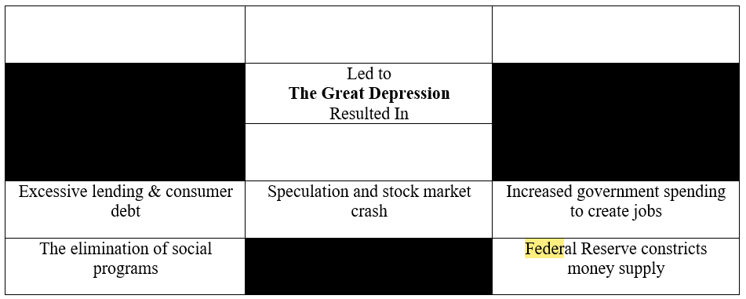
The Great Depression was caused by several key factors, resulting in a dramatic change in American society. Identify the factors that led to the Great Depression. Then identify the resulting action that was taken to address the negative conditions of the Great Depression. Move the labels into the correct blank boxes on the chart. • You do not need to use all of the labels.

Slide 64
Effective historians must employ a thorough understanding of cause and effect.
A. Identify two factors that led to the Great Depression.
B. Then, describe how each factor you identified led to the Great Depression. Write your answer in the space provided.

Slide 65
WW II
Jewish Holocaust
Totalitarianism
American Minorities
Jewish Holocaust
Atomic bomb used by America
United Nations

Slide 66
The following question has two parts. First, answer part A. Then, answer part B. On August 6 and 9, 1945, the United States dropped atomic bombs on the Japanese cities of Hiroshima and Nagasaki.
Part A: How did the Soviet Union respond to this military action?
A. It accelerated the pace of its military invasion of Germany.
B. It formed an alliance with the United States to share nuclear technology.
C. It intensified development on and successfully tested its own nuclear weapons.
D. It withdrew from international organizations in which the United States was also a member.

Slide 67
Part B: Why did the Soviet Union respond in the way that you identified in Part A?
A. It wanted to quickly end the war to avoid further military casualties.
B. It wanted to retain political and military influence in the post-war world.
C. It wanted nuclear technology to be available as a cheap source of energy after the war.
D. It wanted to pursue a policy of isolationism following the devastation caused by World War II.

Slide 68
During World War II, the U.S. government created a system to ration the distribution of certain resources such as petroleum. How did this new system of regulation affect the distribution of resources in the United States?
A. It granted more privileges to wealthy business owners.
B. It provided more goods and services to the working class.
C. It limited the number of goods individuals could purchase.
D. It supplied members of the upper class better quality goods.

Slide 69
Cold War
1945-1991
Containment of Communism
MAD

Slide 70
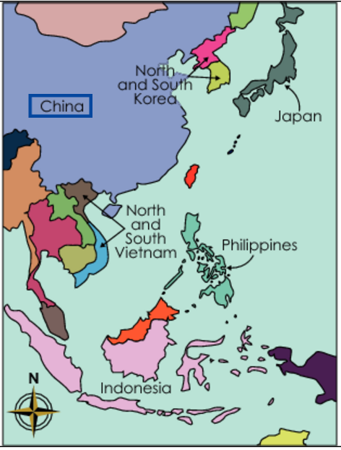
The United States engaged in two wars in Asia during the Cold War Era in an attempt to prevent the spread of communism. Identify two contested areas labeled on the map in which the U.S. fought wars during this time.

Slide 71
During the Cold War, the United States engaged in military actions in both Korea and Vietnam. Its actions were successful in South Korea, but not in Vietnam. In both instances, however, the aim of the United States was the same.
Describe the policy the United States was pursuing by engaging in these wars. Write your answer in the space provided.

Slide 72
Cold War
Marshall Plan
Berlin Blockade & Airlift
Berlin Wall
Bay of Pigs
Cuban Missile Crisis
Korean War
Vietnam War
Iron Curtain
McCarthyism
Domino Effect
NATO & Warsaw Pact
Détente
United Nations
Arms Race
Space Race

Slide 73
Who was in charge of investigating claims of communist activity in the government, armed forces, universities, and other areas of American life during the Second Red Scare in the late 1940s and early 1950s?
A. Ethel and Julius Rosenberg
B. Whittaker Chambers and Alger Hiss
C. House Un-American Activities Committee
D. Senate Committee on Homeland Security and Governmental Affairs

Slide 74
During the 1950s, increased incomes and easy credit led many Americans to embrace which phenomenon?
A. Consumerism
B. feminism
C. progressivism
D. socialism

Slide 75
End of the Cold War
1990-91
Why?
The U.S outlasted the Soviet Union
Soviet Union ran out of materials and money
Market Economy vs. Command Economy
Key Events?
Nov. 9, 1989 - Berlin Wall Falls
Fall of Soviet Union (1991)

Slide 76
Describe the effect the end of the Cold War had on the amount of military spending by the U.S. government in the 1990s.

Slide 77
Credibility & Bias
How can you tell whether something is credible or biased?
What is “real news” and what is “fake news”?

Slide 78
Which source would provide the most credible information about the daily life of factory workers during the 1880s?
A. a collection of letters written by a farmer
B. a journal written by an employee at a factory
C. a novel written to encourage factory regulation
D. a pamphlet written by a group opposing unions

Slide 79
Historians evaluate the credibility of sources using a number of criteria. What is one of the criteria that historians consider?
A. the ease of availability of the source
B. the race and gender of the source’s author
C. the accuracy and internal consistency of the source
D. the payment made by the publisher to the source’s author

Slide 80
Cultural Diversity
New Immigration
Nativism
AIM
NOW
NAACP
UFW

Slide 81
1. What perspective held by Hispanic-American agricultural workers led to the creation of the United Farm Workers?
A. Farm workers wanted to become owners of the farms on which they worked.
B. Small family farms needed economic assistance from the federal government.
C. Farm workers needed to organize in order to bargain with farm owners.
D. Large farms could be made more efficient by using modern agricultural technology.

Slide 82
Before the 1950s, most immigrants to the United States came from Europe. What change in immigration policy was reflected in the 1965 Immigration Act?
A. It set large quotas to encourage European immigration.
B. It enforced a complete ban on immigration from China.
C. It imposed stricter quotas on immigration from every country.
D. It allowed more immigrants from Asia, Africa and Latin America.

Slide 83
Which organization was founded on the following ideals?
• a shared perspective of ethnic minorities
• a desire to improve working conditions
• a belief in the effectiveness of collective bargaining
A. United Farm Workers
B. American Indian Movement
C. National Organization for Women
D. Student Nonviolent Coordinating Committee

